Slide 1
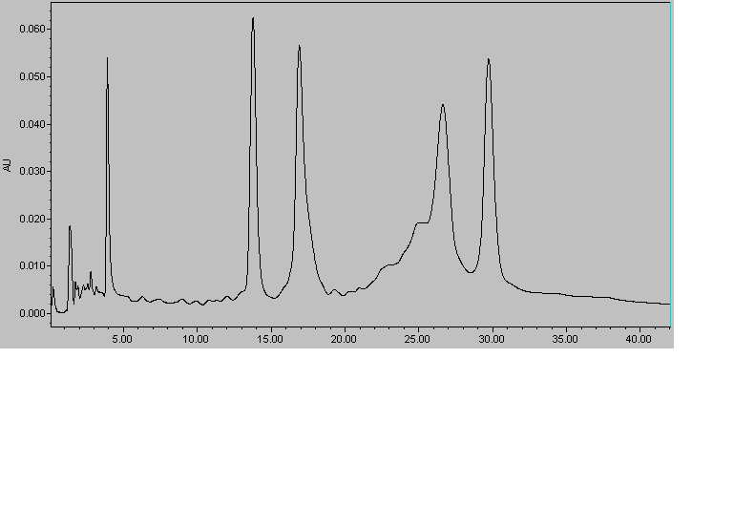
Method: DNA seperation
55c, 260 nm
30 bases
40 bases
60 bases
50 bases
ToeHold-of comp 60 | GGGTGAGATTCCAGCTTAACTTAGTTTTAGTTCCGCTTAGTACTTCTCAGGATCATCCGG
comp-50 | CCGGATGATCCTGAGAAGTACTAAGCGGAACTAAAACTAAGTTAAGCTGG
comp-40 | CCGGATGATCCTGAGAAGTACTAAGCGGAACTAAAACTAA
comp-30 | CCGGATGATCCTGAGAAGTACTAAGCGGAA

Slide 2
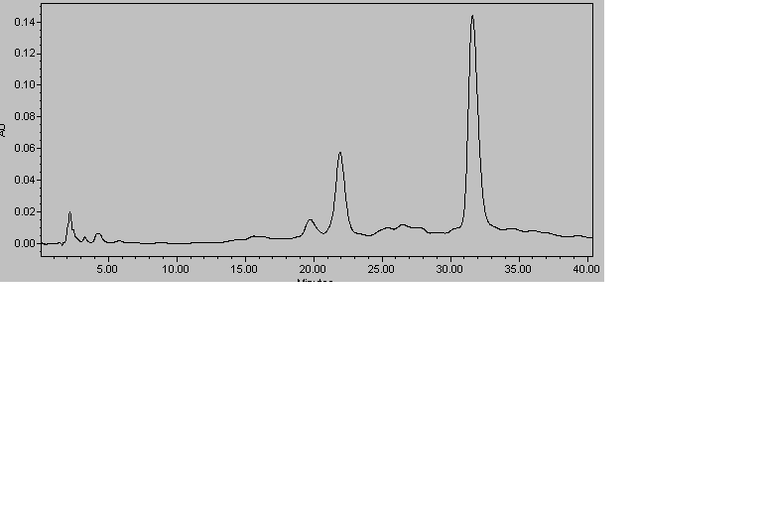
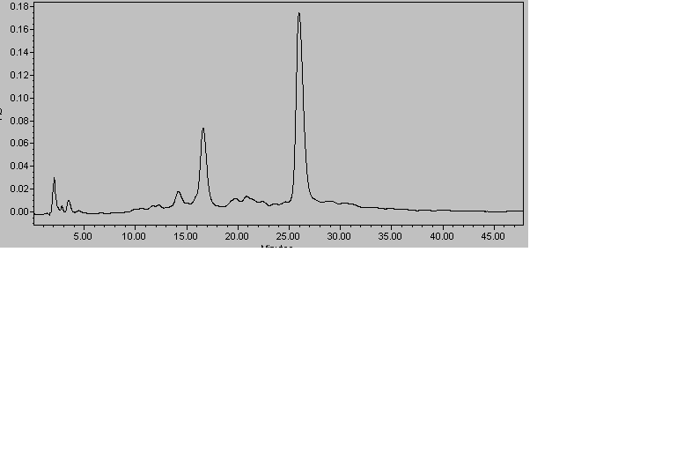
W1-long-Yazide | ATCAACGGCTGGCTGGTTTCTGCTCTCTAGTTTTT(azide)TTTGAGGTGCAATCTCCTATC

